Slide 1
Synopsis presentation on
Fake Tweet Detection Using Multinomial Naïve Bayes Classifier Algorithm
Submitted By :
S SREENIVASA SHENOY (4CB19CS087)
P PADMAPRASAD SHENOY (4CB19CS064)
SUBRAMANYA A SHET (4CB19CS105)
SUHAS S KAMATH (4CB19CS106)
Under the guidance of :
MR. SHATANANDA BHAT P
Assistant Professor
Project Group No. : CEC/CS/2022/P26

Slide 2

Content
Abstract
Introduction
Literature Survey Feedback
Literature Survey Summary
Problem Statement and Description
Objectives
Outcomes
Methodology
System Architecture
Conclusion
Bibliography

Slide 3
Abstract
The proposed system aims to develop a machine-learning model that can detect fake tweets.
This is important because fake tweets can spread misinformation and cause panic.
The dataset used in this study will be a dataset of tweets that have been labelled as fake or not fake.
The machine learning model will be trained on this dataset and then tested on a separate dataset.
The model will be evaluated on its ability to correctly classify fake tweets.

Slide 4
Introduction
Twitter
Difficulties faced by the people because of the fake tweets
Extraction of tweets using Twitter API
Machine Learning
Multinomial Naive Bayes Classifier Algorithm

Slide 5
Literature Survey Feedback
To understand whether it is detecting fake account or fake tweet.
We are detecting fake tweet.
To mention preferred algorithm name in system flowchart design.
Multinomial Naive Bayes Classifier Algorithm(mentioned in flowchart).

Slide 6
Literature Survey Summary
The detailed survey assisted us about various methods and algorithms from different papers.
The detailed survey showed that 70-80% of the studies applied Machine Learning to analyze the data.
It showed us how text pre-processing methods can improve the accuracy of analysis we perform.
It showed us that Naive Bayes algorithm led to better accuracy.

Slide 7
Problem Statement
Extract the set of tweets from twitter, apply the suitable text pre-processing technique, train the model and classify the tweets whether fake or real using the Multinomial Naive Bayes Classifier Algorithm.

Slide 8
Problem Description
The project “Fake Tweet Detection using Multinomial Naive Bayes Classifier Algorithm” aims to help predict whether the tweet is fake or real. Prediction is done using the Multinomial Naive Bayes approach from extracted tweets using Twitter API. The classifier will be trained only on text data. Traditionally text analysis is performed using Natural Language Processing(NLP). NLP is a field that comes under Artificial Intelligence whose main focus is on letting computers understand human language and process it. In the project, Training Data is pre-processed, then sent to the classifier, then the classifier predicts whether the tweet is real or fake.

Slide 9
Objectives
To extract the tweets using Twitter API and apply pre-processing methods on the extracted data.
To train and classify whether it is fake or real tweets by using the Multinomial Naive Bayes Classifier Algorithm.

Slide 10
Outcomes
A model is implemented to extract the tweets and preprocess the data.
A model is implemented to train and classify whether it is fake or real tweets by using the Multinomial Naive Bayes Classifier Algorithm.

Slide 11
Methodology
Identification of data:
In this project, the detection of fake or real tweets is done using the Multinomial Naive Bayes approach from extracted tweets by using Twitter API. This project works only on text data. It has five columns:
Id: tells the unique identification of each tweet
Text: It tells the tweet in text form
Location: It tells the place from where the tweet was sent and it can be blank
Keyword: It tells a particular word in the tweet and it can be blank
Target: It tells the actual value of the tweet whether it’s a real tweet or fake

Slide 12
Data-preprocessing:
First, the preprocessing is done in the dataset which includes the removal of punctuations, then the removal of URLs, digits, non-alphabets and contractions, then tokenization and removing Stopwords.
Then, lemmatization is done on the dataset.
After preprocessing, the Countvectorizer is used to convert text data into numerical data as the classifier only works for numerical data.
The dataset is then split into 70% training data and 30% test data.
Definition of Training Data:
The training dataset which contains 70% of the whole dataset is used for training the model.

Slide 13
Algorithm:
Multinomial Naive Bayes classifier algorithm is used for detecting disaster tweets whether they are fake or real.
Evaluation with test set:
Several text samples are passed through the model to check whether the classification algorithm gives the correct result or not.

Slide 14
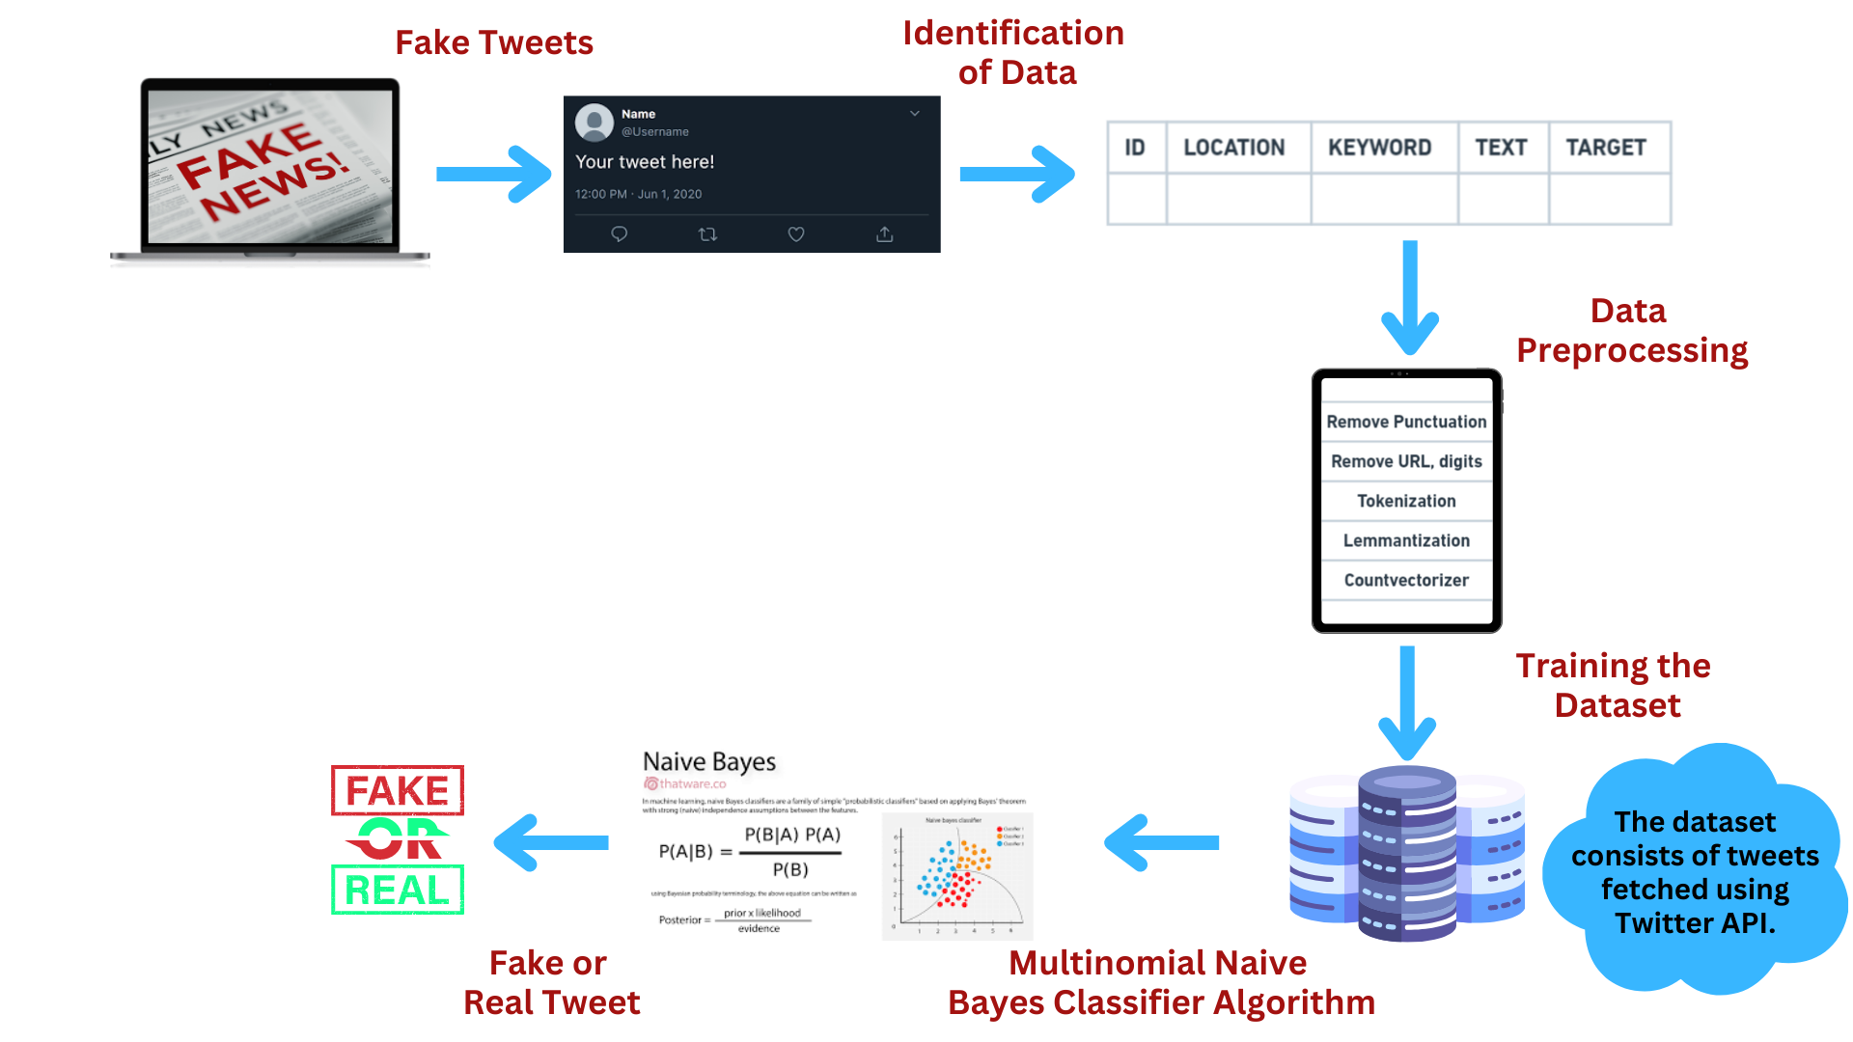
System Architecture

Slide 15
Conclusion
The proposed system focuses on extracting the data from Twitter.
The proposed method has proven to be an effective and reliable way of predicting the correct class labels of our data.
The proposed algorithm is applied on the pre-processed data to further classify it into real or fake.
The proposed algorithm is able to accurately classify tweets as being genuine or fake with a high degree of accuracy.
The proposed algorithm is efficient and straightforward to use, and it has been widely adopted by many industries.
The proposed algorithm can be easily trained and implemented on large data sets.

Slide 16
Bibliography
[1] V. Gupta, R. S. Mathur, T. Bansal, and A. Goyal, “Fake News Detection using Machine Learning,” 2022 Int. Conf. Mach. Learn. Big Data, Cloud Parallel Comput. COM-IT-CON 2022, vol. 5, no. 5, pp. 84–89, 2022, doi: 10.1109/COM-IT-CON54601.2022.9850560.
[2] M. Looijenga, “The Detection of Fake Messages using Machine Learning,” Retrieved Sept., vol. 1, p. 2021, 2018, [Online]. Available: http://essay.utwente.nl/77385/
[3] N. Guimarães, Á. Figueira, and L. Torgo, “Can fake news detection models maintain the performance through time? A longitudinal evaluation of twitter publications,” Mathematics, vol. 9, no. 22, 2021, doi: 10.3390/math9222988.
[4] T. Jiang, J. P. Li, A. U. Haq, A. Saboor, and A. Ali, “A Novel Stacking Approach for Accurate Detection of Fake News,” IEEE Access, vol. 9, pp. 22626–22639, 2021, doi: 10.1109/ACCESS.2021.3056079.
[5] M. Al-Sarem et al., “An improved multiple features and machine learning-based approach for detecting clickbait news on social networks,” Appl. Sci., vol. 11, no. 20, 2021, doi: 10.3390/app11209487.

Slide 17
[6] Y. Fang, J. Gao, C. Huang, H. Peng, and R. Wu, “Self Multi-Head Attention-based Convolutional Neural Networks for fake news detection,” PLoS One, vol. 14, no. 9, pp. 1–13, 2019, doi: 10.1371/journal.pone.0222713.
[7] J. W. Lee and J. H. Kim, “Fake Sentence Detection Based on Transfer Learning: Applying to Korean COVID‐19 Fake News,” Appl. Sci., vol. 12, no. 13, 2022, doi: 10.3390/app12136402.
[8] A. Galli, E. Masciari, V. Moscato, and G. Sperlí, “A comprehensive Benchmark for fake news detection,” J. Intell. Inf. Syst., vol. 59, no. 1, pp. 237–261, 2022, doi: 10.1007/s10844-021-00646-9.
[9] S. Helmstetter and H. Paulheim, “Collecting a large scale dataset for classifying fake news tweets using weak supervision,” Futur. Internet, vol. 13, no. 5, 2021, doi: 10.3390/fi13050114.
[10] L. Hu, S. Wei, Z. Zhao, and B. Wu, “Deep learning for fake news detection: A comprehensive survey,” AI Open, 2022, doi: 10.1016/j.aiopen.2022.09.001.
[11] S. S. Nikam* and P. R. Dalvi, “Fake News Detection on Social Media using Machine Learning Techniques,” Int. J. Innov. Technol. Explor. Eng., vol. 9, no. 7, pp. 940–943, 2020, doi: 10.35940/ijitee.g5428.059720.
[12] S. Ahmed, K. Hinkelmann, and F. Corradini, “Combining machine learning with knowledge engineering to detect fake news in social networks - A survey,” CEUR Workshop Proc., vol. 2350, 2019.

Slide 18
[13] A. Shrestha, F. Spezzano, and A. Joy, “Detecting Fake News Spreaders in Social Networks via Linguistic and Personality Features Notebook for PAN at CLEF 2020,” CEUR Workshop Proc., vol. 2696, no. September, pp. 22–25, 2020.
[14] J. Y. Khan, M. T. I. Khondaker, S. Afroz, G. Uddin, and A. Iqbal, “A benchmark study of machine learning models for online fake news detection,” Mach. Learn. with Appl., vol. 4, p. 100032, 2021, doi: 10.1016/j.mlwa.2021.100032.
[15] M. S. Espinosa, R. Centeno, and Á. Rodrigo, “Analyzing User Profiles for Detection of Fake News Spreaders on Twitter,” Work. Notes CLEF 2020 - Conf. Labs Eval. Forum, no. September, pp. 22–25, 2020.
[16] F. Monti, F. Frasca, D. Eynard, D. Mannion, and M. M. Bronstein, “Fake News Detection on Social Media using Geometric Deep Learning,” pp. 1–15, 2019, [Online]. Available: http://arxiv.org/abs/1902.06673
[17] M. Hernandez-Mendoza, A. Aguilera, I. Dongo, J. Cornejo-Lupa, and Y. Cardinale, “Credibility Analysis on Twitter Considering Topic Detection,” Appl. Sci., vol. 12, no. 18, pp. 1–25, 2022, doi: 10.3390/app12189081.
[18] Y. Jang, C. H. Park, and Y. S. Seo, “Fake news analysis modeling using quote retweet,” Electron., vol. 8, no. 12, 2019, doi: 10.3390/electronics8121377.

Slide 19
[19] M. J. Awan et al., “Fake news data exploration and analytics,” Electron., vol. 10, no. 19, 2021, doi: 10.3390/electronics10192326.
[20] D. Mouratidis, M. N. Nikiforos, and K. L. Kermanidis, “Deep learning for fake news detection in a pairwise textual input schema,” Computation, vol. 9, no. 2, pp. 1–15, 2021, doi: 10.3390/computation9020020.

